Slide 1

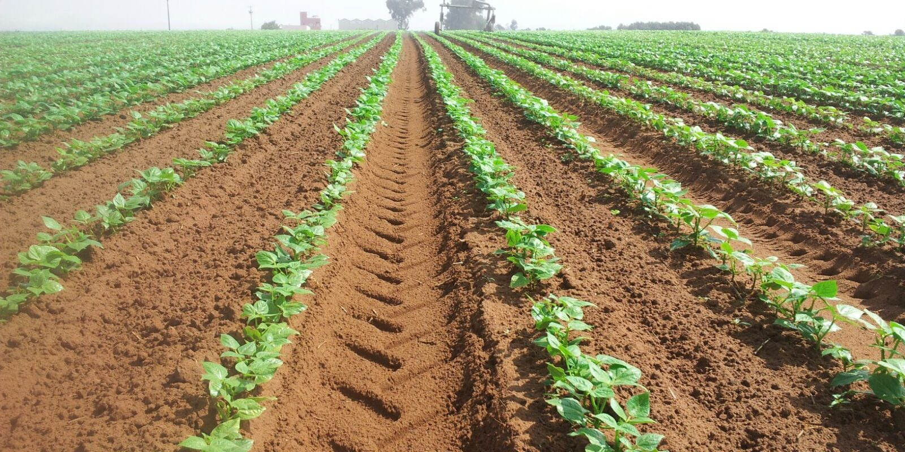
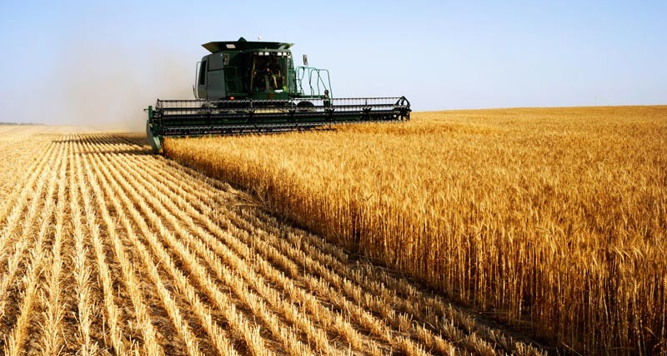
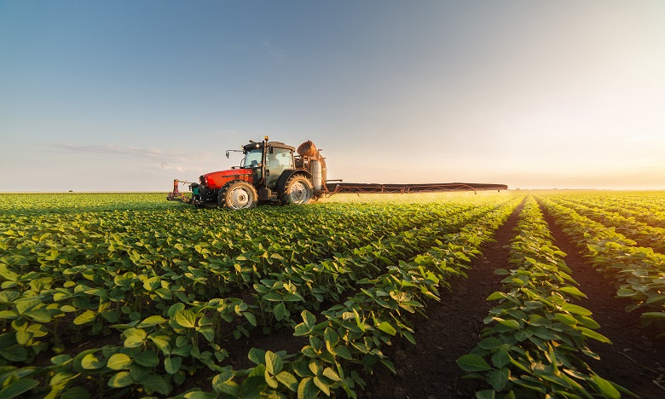

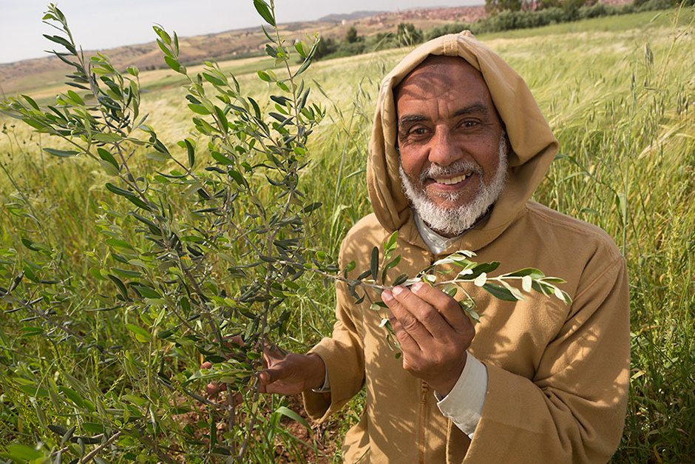
Agricultural Chatbot for Moroccan Farmers
Flahti

Slide 2
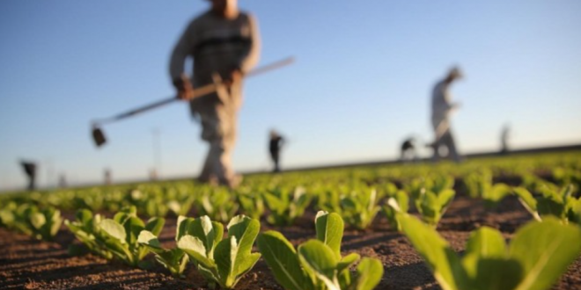
Introduction

Slide 3
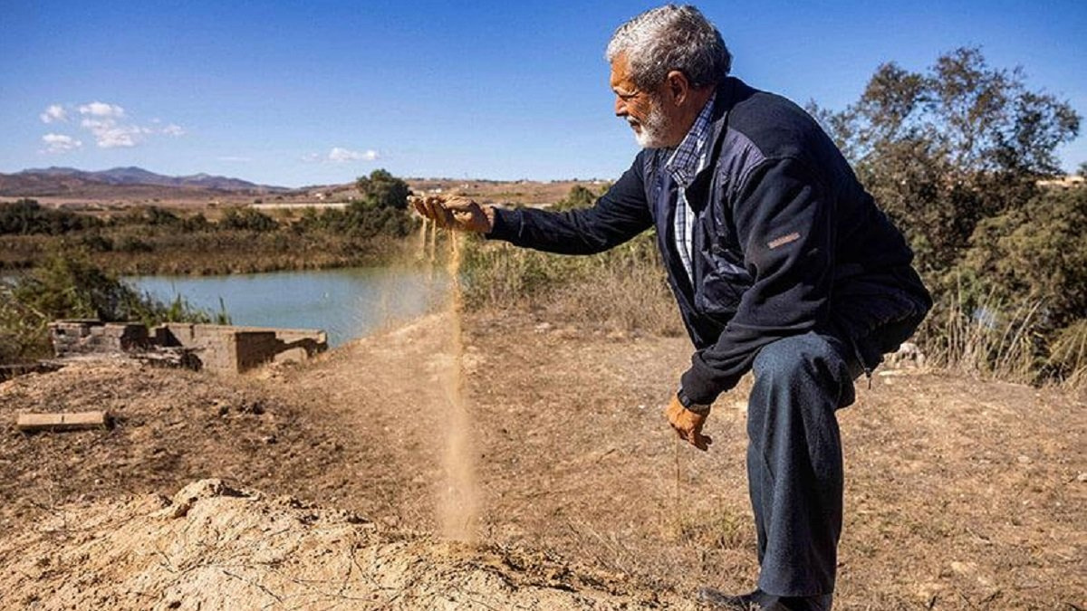
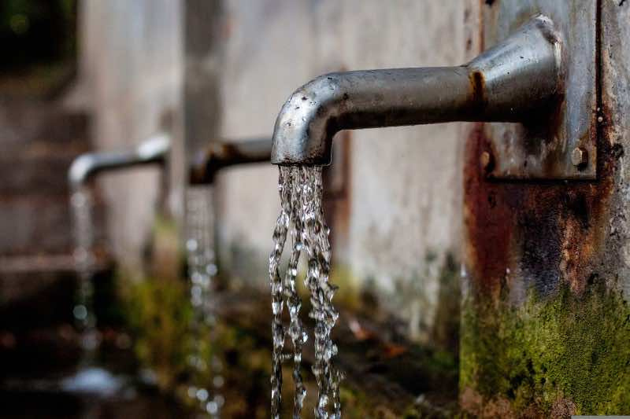
Flahti
Problems facing our moroccan farmers today
Inefficient Water Management / Drought Conditions

Slide 4
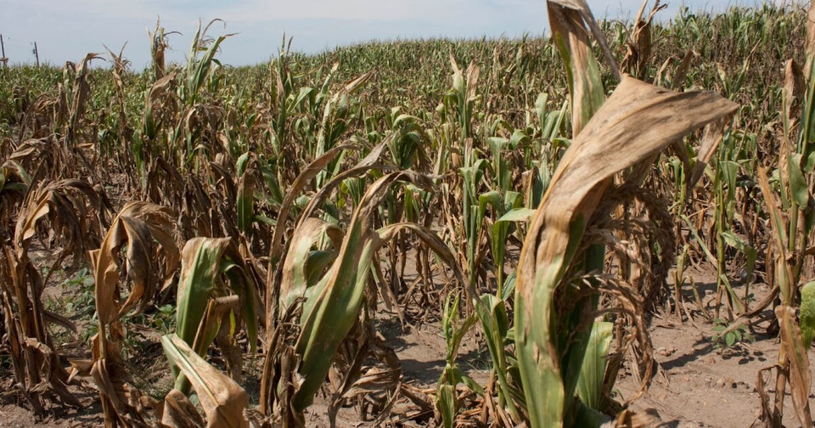

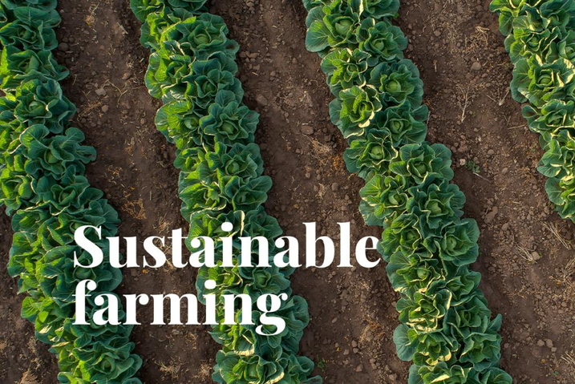
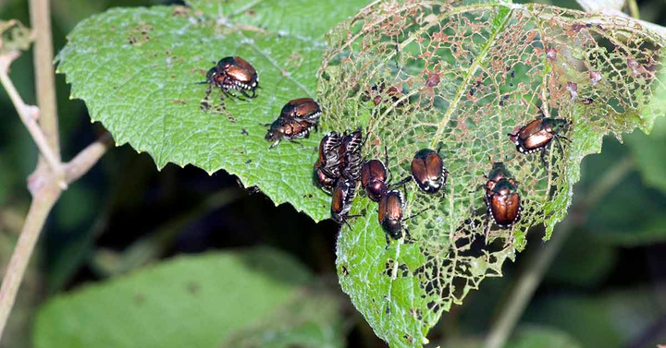
Lack of agricultural education and guidance
Poor Crop Selection
Ineffective farm planning
Neglect of Sustainable Practices
Improper Pest and Disease Control

Slide 5
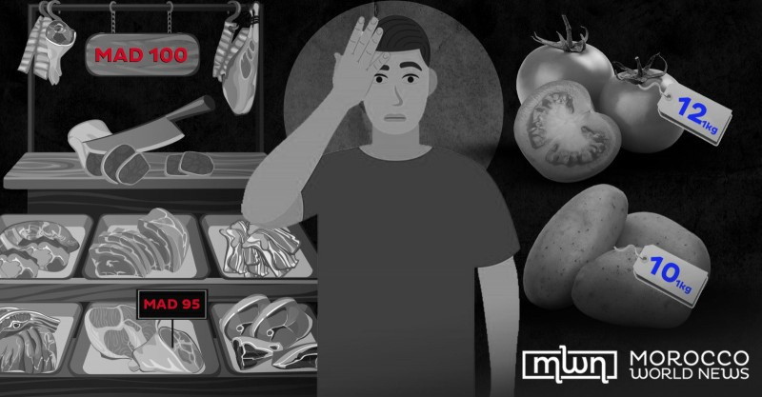
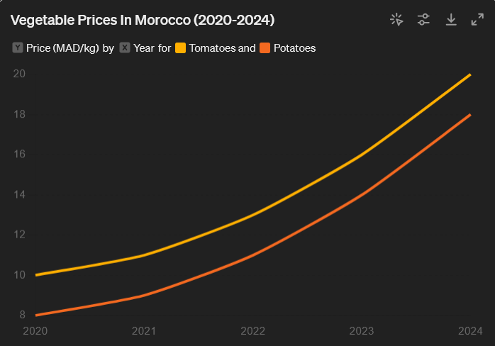
Flahti
Consequences
Rising Inflation of vegetables and fruits prices in Morocco

Slide 6








Flahti
Our solution
Technology used
A comprehensive agricultural chatbot

Slide 7



Flahti
Dataset

Slide 8

Flahti
Key features
1. Crop Selecti﻿on Guidance in different moroccan regions
6. Farm Management and Planning
2. Pest and Disease management
7. Sustainable Farming Practices
3. Optimal Growing Conditions
8. Market Information
4. Optimal Growing Conditions
10. Government Schemes and Support
5. Water Management

Slide 9

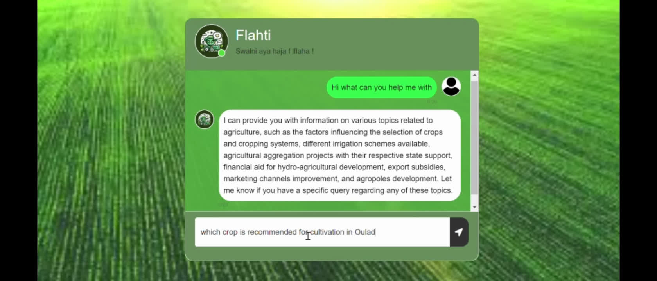
Flahti
Demo video
Our solution

Slide 10
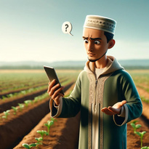


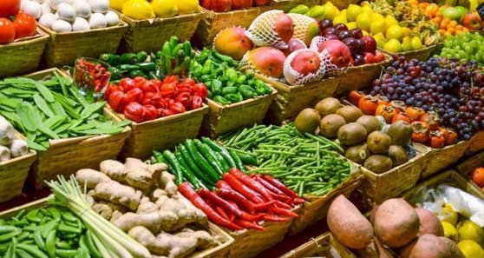

Flahti
Why use our product ?
Access to Expert Knowledge
Enhanced Farm Management
Increased Productivity and Profitability
Market Information
Farm Management and Planning

Slide 11



Flahti
Future work
Introduce moroccan dialect model in our chatbot
More Data
Voice input option

Slide 12

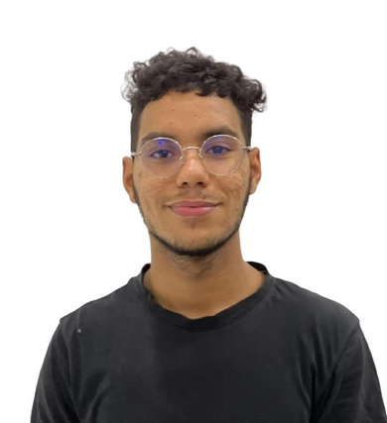
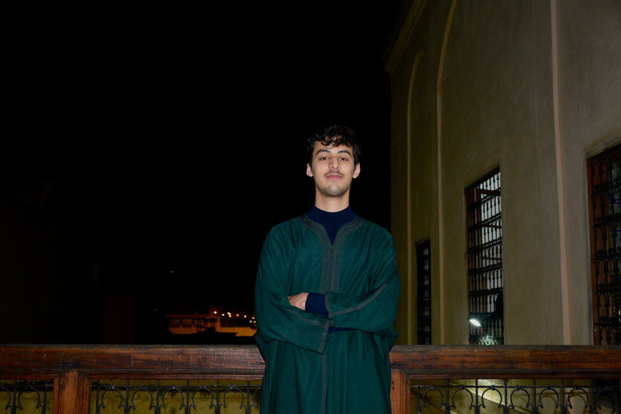
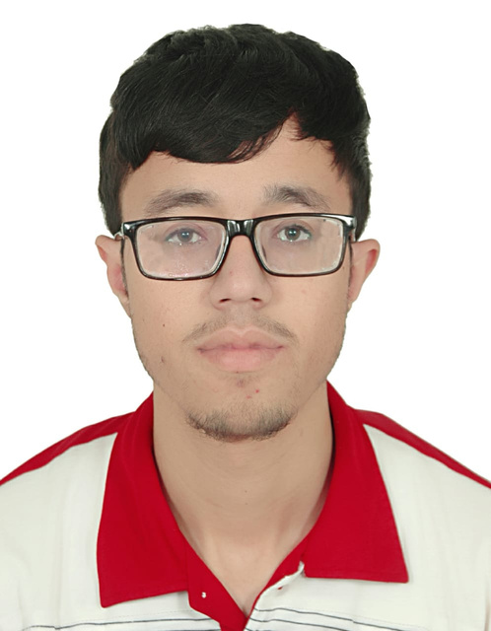
Flahti
Our team
Yosri Mehjoubi
Khalil Hamdaoui
Mohamed ALAOUI
MHAMDI

Slide 13

Flahti
Thank you

